Slide 1
Running your first computation model
under an hour!

Slide 2
Outline
From statistics to computation model
Simulating Strain effect
Quick walkthrough
Hands-on!
Other resources recommendation

Slide 3


From statistics to computation model
Data wrangling
data.table
dplyr
Modeling
ez, lme4, lavaan, OpenMx…
Visualization
ggplot, plotly
Data wrangling
Pandas → functionality
Numpy → Speed
Modeling
Tensorflow2, pytorch
Visualization
Matplotlib, Altair

Slide 4

TensorFlow
Tensorflow is a library on python
Current version is v2.1
Don’t read v1.x documentations, completely changed
Some features I like
Options to write in high-level API (KERAS), mid-level KERAS class object, or low level tf function
Scalable: No need to change your code to run on cluster
Many users

Slide 5
Environment: Google CoLaboratory
The goods
Free GPU!
Zero setup
Always up to date
Github integration
The bads
Session timeout
Max run time (12 hours continuously)
Interface is a bit slow

Slide 6
What are we going to do
Simulate Strain effect using a feed forward O to P model
How?
Representation
Architecture
Training
Performance metrics

Slide 7
Orthographic representation
Prep
One-hot encoding for categorical data at letter level (Dummy variable for categorical data in regression)
Create a mapping table for letter to binary bits
a = [0, 1, 0 ,0 ,0, … ,0]
b = [0, 0, 1, 0, 0, … ,0]
Convert word to bits of features
“abc” = [0, 1, 0, …, 0], [0, 0 ,1, 0…,0], [0, 0, 0, 1,…,0]
Because the model won’t deal with missing data, we need to pad blank spaces and make the input dimension consistent across words
“abc” = “______abc” = [1, 0, 0, …, 0] …, [0, 1, 0, …, 0], [0, 0 ,1, 0…,0], [0, 0, 0, 1,…,0]
Model
Visualize

Slide 8
Phonological representation
Prep
I want to try something new for this demo… (for validating previous results)
Use SAMPA
https://www.phon.ucl.ac.uk/home/sampa/english-uni.htm
Example
Came → k"em
No extra conversion steps (for simplicity)
No manual alignment
Model
Visualize

Slide 9
Architecture
Prep
Phonology
Orthography (Input)
Hidden layer
Phonology (Output)
Parameters
Activation function
No. of hidden unit
Model
Hidden
Visualize
Orthography

Slide 10
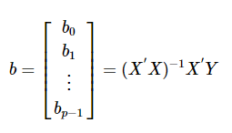
Training
Prep
Classical statistics (Much faster)
Neural network (Much more flexible)
Model
Solve it deterministically…
Given: X + Y = 3 and X – Y = 1
Therefore: 2X = 4 → X = 2 → Y = 1
In matrix algebra form…
Solve it by trial-and-(minimizing)-error
Create some function to represent error (Cost)
In linear regression: RMSE
Procedure (Gradient descent)
Start with random guessing
Calculate cost and Δcost w.r.t. Δparameters
Move parameters towards lower cost direction, and go to 2 until not much change… (learning rate)
Visualize
Solving multiple regression

Slide 11
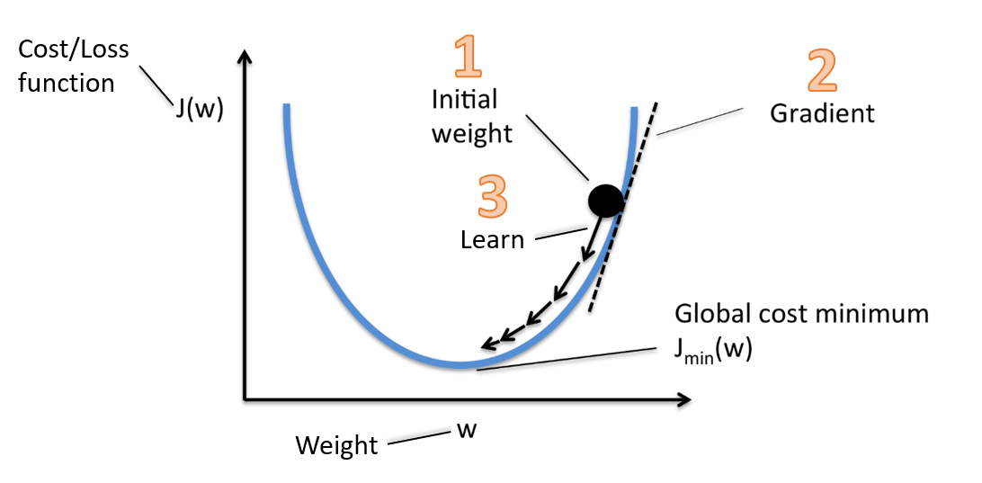
Training
Prep
Neural network (Much more flexible)
Model
Solve it by trial-and-(minimizing)-error
Create some function to represent error (Cost)
In linear regression: RMSE
Procedure (Gradient descent)
Start with random guessing
Calculate cost and Δcost w.r.t. Δparameters
Move parameters towards lower cost direction, and go to 2 until not much change… (learning rate)
Visualize

Slide 12
Terminology: Sample, batch, epoch
Prep
Sample = no. of item/trials
Batch = how many sample are used in one gradient descent
Epoch = total number of sample in a training set
Model
Visualize

Slide 13
Performance metrics
Prep
Depends on your output format and type
Basic (works for most)
Accuracy
Mean squared error
Many prebuild options
https://keras.io/metrics/
Model
Visualize

Slide 14
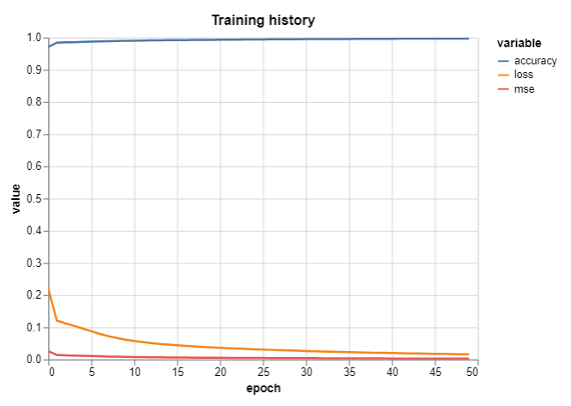
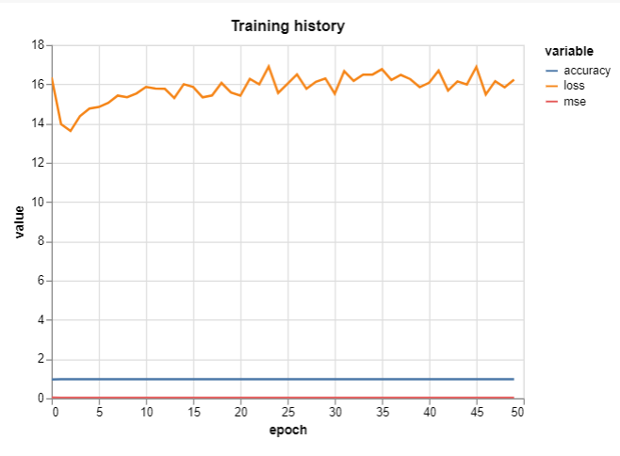
Visualize
Prep
Training history
Evaluate loss and performance metrics in each epoch
Which one below you prefer seeing? Why?
Model
Visualize

Slide 15
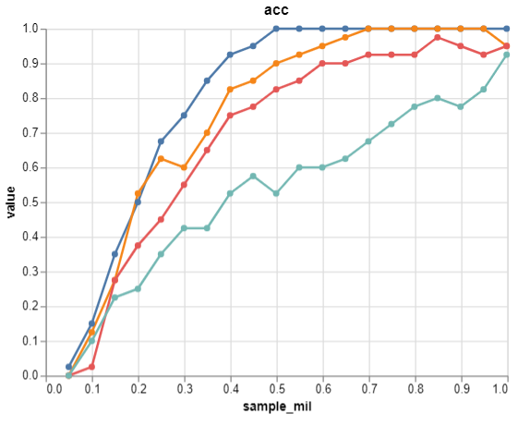

Experiment (Strain) result
Prep
Main effect of consistency
CON > INC
Main effect of frequency
HF > LF
Consistency and frequency interaction
CON_HF – CON_LF < INC_HF – INC_LF
Model
Visualize

Slide 16
https://bit.ly/39Nev2L
Hand on time!

Slide 17
Troubleshooting
Stupid error, fat finger
Representations
Metrics
Architecture
Parameters

Slide 18
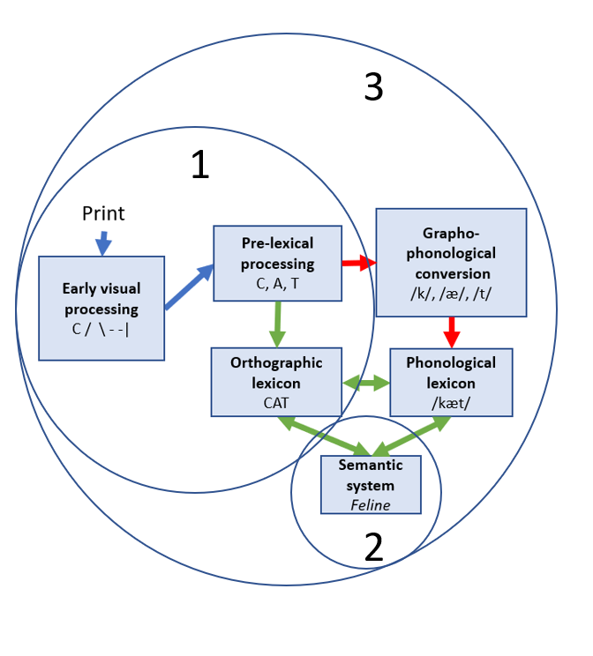
What next?
How the parameters (e.g. noise in P system, no. of hidden unit) influence experiment results?
Some O2P results
Introduce more “realistic” architecture
Convolutional neural network
Semantic embedding
Recurrent neural network

Slide 19




(Too many) Resources
Environment
Local:
Remote fully managed notebook with scalable GPUs
Short news articles
https://towardsdatascience.com/
https://hackernoon.com/tagged/ai
Google AI platform

Slide 20
Resources
Python
https://learn.datacamp.com/
https://visualstudio.microsoft.com/dev-essentials/ (Get 3 months free trial for datacamp)
Too many other…
ML
https://www.tensorflow.org/hub
https://aihub.cloud.google.com/u/0/
https://www.kaggle.com/

Slide 21
Discussion
What is the linguistic properties inside a computation modeling? Predefined vs. learned by the model itself?
Consistency
Frequency
Semantic neighborhood…

Slide 22
My thoughts
Statistics (reflection of Noam sharing)
Computation modeling
Quantifying linguistic properties can be quite tricky
Linguistic property is an outcome of learning?
Semantic neighborhood: somewhat reflected on the semantic space “density”

